Slide 1

Architect an Azure Compute Infrastructure
ARM Virtual Machines
ARM Templates
Design for Availability
Containers
Ashish Sharma
Cloud Solutions Architect -Microsoft

Slide 2
Exam 70-534 Architecting Microsoft Azure Solutions
#1 Design Azure Resource Manager (ARM) networking (5–10%)
Design Azure virtual networks - Extend on-premises
Describe Azure VPN and Express Route architecture and design
#2 Secure resources (20–25%)
Secure resources by using managed identities
Secure resources by using managed identities
Secure resources by using identity providers
Identify an appropriate data security solution
Design a role-based access control (RBAC) strategy
Manage security risks by using an appropriate security solution
#3 Design an application storage and data access strategy (5–10%)
Design data storage
Select the appropriate storage option
#4 Design advanced applications (20–25%)
Create compute-intensive applications
Create long-running applications
Integrate Azure services in a solution
Implement messaging applications
Implement applications for background processing
Design connectivity for hybrid applications
#5 Design Azure Web and Mobile Apps (5–10%)
Design Web Applications
Design Mobile Applications
#6 Design a management, monitoring, and business continuity strategy (20–25%)
Design a monitoring strategy
Describe Azure business continuity/disaster recovery (BC/DR) capabilities
Design a disaster recovery strategy
Design Azure Automation and PowerShell workflows
Describe the use cases for Azure Automation configuration
#7 Architect an Azure Compute infrastructure (10–15%)
Design ARM Virtual Machines (VMs)
Design ARM template deployment
Design for availability
https://www.microsoft.com/learning/en-us/exam-70-534.aspx

Slide 3
#7 Architect an Azure Compute infrastructure (10–15%)
Design ARM Virtual Machines (VMs)
Design VM deployments leveraging availability sets, fault domains, and update domains in Azure; select appropriate VM SKUs
Design ARM template deployment
Author ARM templates; deploy ARM templates via the portal, PowerShell, and CL
Design for availability
Implement regional availability and high availability for Azure deployments

Slide 4
Architect an Azure Compute Infrastructure
Design ARM Virtual Machines
VM SKUs
Availability Sets
ARM Template Deployment
Author ARM Templates
Deploy ARM Templates
Portal
Powershell
CLI
Design for Availability
Regional Availability
High Availability

Slide 5
VMs

Slide 6
VMs
When you pay for a VM, this is what you are paying for: Cores, RAM, Temp Disk
What is a VM?
Cores (CPUs)
RAM
Temp Disk
Disks
Network Interface Cards
Pricing is charged by the hour.
Partial hours are charged by the minute.
Storage is priced and charged separately.
Limits
Learn about default and Maximum Limits. Eg.20 cores per region. 10,000 Max.
Windows/Linux
Containers
Encryption
Memory, CPU, Disk, Network intensive?
How many cores
How much disk space
SSDs required
IOPS required
How many NICs
Networking Speed
Notes:
Limits: https://docs.microsoft.com/en-us/azure/azure-subscription-service-limits#virtual-machines-limits
Pricing - https://azure.microsoft.com/en-us/pricing/details/virtual-machines/linux/
Vertical scaling - https://docs.microsoft.com/en-us/azure/virtual-machines/linux/vertical-scaling-automation?toc=%2fazure%2fvirtual-machines%2flinux%2ftoc.json

Slide 7
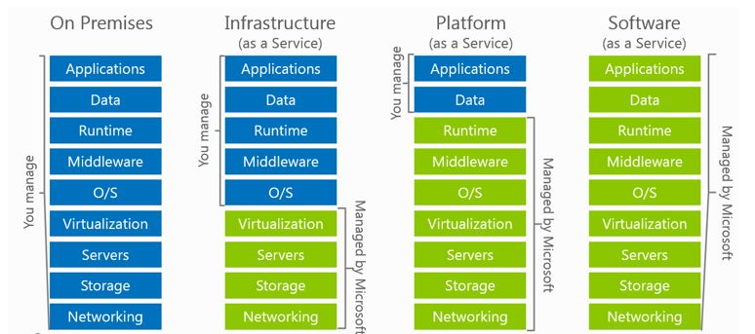
VMs or Paas? – What is the workload
Use VMs
Lift & Shift
Existing Deployment Model
OS customization required
Installed Dependencies required
Hardcoded lookups (Folders, drive letters, etc)
Portability
Notes:
If you want to lift and shift an app – for example, a legacy app
You need to customize the OS and install depend

Slide 8
VMs – Supported Operating Systems
Linux distributions and versions supported on Azure
Linux
CentOS
CoreOS
Debian
Oracle
Red Hat
SUSE
openSUSE
Ubuntu
Windows Server
Windows 2003* https://support.microsoft.com/en-us/help/3206074
Windows 2008R2+
Distribution | Version | Drivers | Agent
CentOS | CentOS 6.3+, 7.0+ | CentOS 6.3: LIS download CentOS 6.4+: In kernel | Package: In repo under "WALinuxAgent" Source code: GitHub
CoreOS | 494.4.0+ | In kernel | Source code: GitHub
Debian | Debian 7.9+, 8.2+ | In kernel | Package: In repo under "waagent" Source code: GitHub
Oracle Linux | 6.4+, 7.0+ | In kernel | Package: In repo under "WALinuxAgent" Source code: GitHub
Red Hat Enterprise Linux | RHEL 6.7+, 7.1+ | In kernel | Package: In repo under "WALinuxAgent" Source code: GitHub
SUSE Linux Enterprise | SLES/SLES for SAP 11 SP4 12 SP1+ | In kernel | Package: for 11 in Cloud:Tools repo for 12 included in "Public Cloud" Module under "python-azure-agent" Source code: GitHub
openSUSE | openSUSE Leap 42.1+ | In kernel | Package: In Cloud:Tools repo under "python-azure-agent" Source code: GitHub
Ubuntu | Ubuntu 12.04, 14.04, 16.04, 16.10 | In kernel | Package: In repo under "walinuxagent" Source code: GitHub
Notes:
https://docs.microsoft.com/en-us/azure/virtual-machines/linux/endorsed-distros
Bring your own image for windows server 2003

Slide 9
VM Sizes
Type | Sizes | Description
General purpose | B (Preview), Dsv3, Dv3, DSv2, Dv2, DS, D, Av2, A0-7 | Balanced CPU-to-memory ratio. Ideal for testing and development, small to medium databases, and low to medium traffic web servers.
Compute optimized | Fs, F | High CPU-to-memory ratio. Good for medium traffic web servers, network appliances, batch processes, and application servers.
Memory optimized | Esv3, Ev3, M, GS, G, DSv2, DS, Dv2, D | High memory-to-CPU ratio. Great for relational database servers, medium to large caches, and in-memory analytics.
Storage optimized | Ls | High disk throughput and IO. Ideal for Big Data, SQL, and NoSQL databases.
GPU | NV, NC | Specialized virtual machines targeted for heavy graphic rendering and video editing. Available with single or multiple GPUs.
High performance compute | H, A8-11 | Our fastest and most powerful CPU virtual machines with optional high-throughput network interfaces (RDMA).
Notes:
B series - https://buildazure.com/2017/09/11/more-affordable-azure-vms-with-burstable-b-series/
Determine Cores, RAM, ACUs, Disks, NICs, Network Speed, Temporary Storage, SSD support
High level categories:

Slide 10
VM Azure Compute Unit (ACU)
SKU Family | ACU \ vCPU
A0 | 50
A1-A4 | 100
A5-A7 | 100
A1_v2-A8_v2 | 100
A2m_v2-A8m_v2 | 100
A8-A11 | 225*
D1-D14 | 160
D1_v2-D15_v2 | 210 - 250*
DS1-DS14 | 160
DS1_v2-DS15_v2 | 210-250*
D_v3 | 160-190* **
Ds_v3 | 160-190* **
E_v3 | 160-190* **
Es_v3 | 160-190* **
F1-F16 | 210-250*
F1s-F16s | 210-250*
G1-G5 | 180 - 240*
GS1-GS5 | 180 - 240*
H | 290 - 300*
L4s-L32s | 180 - 240*
M | 160-180**
Provide a way of comparing compute (CPU) performance across Azure SKUs
Not all Azure Cores are created equal
A1 Core != F1 Core
Compare compute (CPU) performance across SKUs.
Notes:
Not all Azure Cores are created equal
A1 Core != F1 Core
Compare compute (CPU) performance across SKUs.
https://docs.microsoft.com/en-us/azure/virtual-machines/windows/acu
Azure Compute Unit (ACU) to provide a way of comparing compute (CPU) performance across Azure SKUs. This will help you easily identify which SKU is most likely to satisfy your performance needs. ACU is currently standardized on a Small (Standard_A1) VM being 100 and all other SKUs then represent approximately how much faster that SKU can run a standard benchmark.
ACUs marked with a * use Intel® Turbo technology to increase CPU frequency and provide a performance boost. The amount of the boost can vary based on the VM size, workload, and other workloads running on the same host.+
**Hyper-threaded.

Slide 11
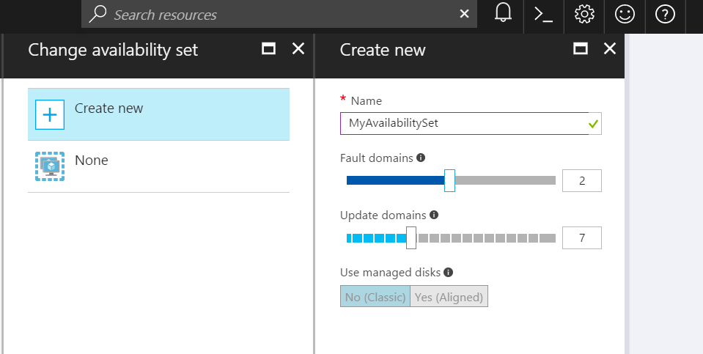
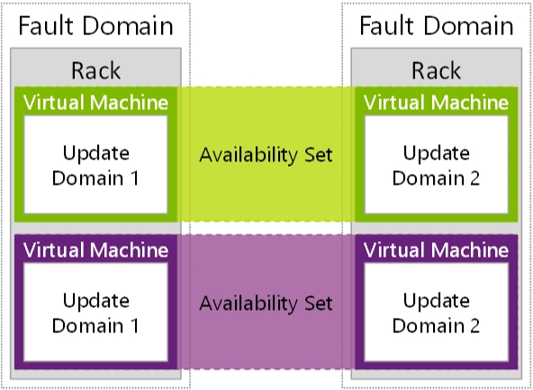
Availability Sets
Availability Sets are for Unplanned & Planned Maintenance
Fault Domains (2 default, some regions allow 3)
Upgrade Domains (5 default, 1-20 allowed)
Front with Load Balancer, App Gateway
Notes:
To provide redundancy to your application, we recommend that you group two or more virtual machines in an availability set.
Fault domain – collection of resources that may fail at the same time due to same root cause. Servers in same rack are part of same fault domain. A fault domain has a single point of failure. Place resources in separate fault domain so that they remain available in case of a failure
Update domain – logical collection of resources that can be updated at the same time. One update domain has updates applied at a time and may require rebooting. Pleace resources in separate update domains – it is automatic
One update domain has updates applied at a time
Availability set – can place vm’s in an availability set at creation or after deployment . Moving a vm in or out of availability set causes it to reboot
https://docs.microsoft.com/en-us/azure/virtual-machines/windows/manage-availability

Slide 12
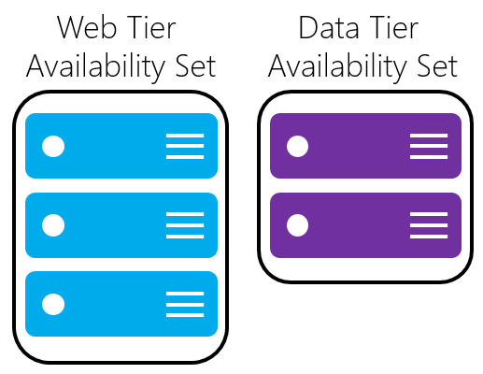
Availability Sets
Do NOT put a single VM in an Availability Set
Example - for an application,
Place front-end virtual machines in the same availability set
AND
Data-tier virtual machines in their own availability set
Notes:
Fault domain – collection of resources that may fail at the same time due to same root cause. Servers in same rack are part of same fault domain. A fault domain has a single point of failure. Place resources in separate fault domain so that they remain available in case of a failure
Update domain – logical collection of resources that can be updated at the same time. One update domain has updates applied at a time and may require rebooting. Place resources in separate update domains – it is automatic
One update domain has updates applied at a time
Availability set – can place vm’s in an availability set at creation or after deployment . Moving a vm in or out of availability set causes it to reboot

Slide 13
VM Scaling
Resize VMs (Scale up or down)
Offline operation
Just a reboot if in a cluster that supports new size
Requires a deallocation if new size is not supported in the cluster (a little longer)
Scale In or Out
You can create new instances of the VM based on platform images (max 1000) or your own custom images (max 100)
Using VM Scale Sets
Using Azure Automation
Scheduled
Azure Autoscale
System Metrics (CPU, RAM, etc)
Custom Metrics
Notes:
If the VM is part of an availability set and the new size is not supported in the cluster, all VMs in the availability set will need to be deallocated for the resize to happen
https://docs.microsoft.com/en-us/azure/virtual-machines/windows/resize-vm
- Azure Autoscale
System Metrics (CPU, RAM, etc)
Custom Metrics https://docs.microsoft.com/en-us/azure/monitoring-and-diagnostics/monitoring-overview-autoscale#resource-metrics
Scale
Up/Down
In/Out

Slide 14
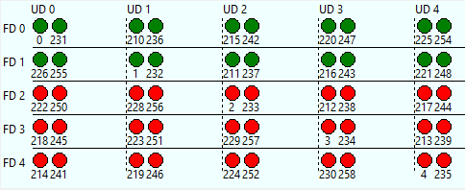
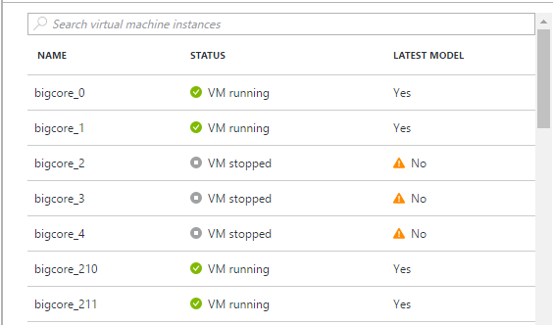
Virtual Machine Scale Sets
Deploy and manage VMs as a set
An Azure Compute resource Microsoft.Compute/virtualMachineScaleSets
Scale - Deploy identical resources
Easily
Rapidly
At scale.. 10s – 10,000s of cores
Low cost - Dynamically increase/decrease compute power to optimize costs
Elasticity - Automatically scale to changing demand
Notes:
https://azure.microsoft.com/en-us/documentation/services/virtual-machines-scale-sets

Slide 15
VM Disks
OS Disk (attached via SATA)
VHD based
Persists
Separate storage cost
Temporary Disk
Doesn’t persist - SSD
No Separate storage cost
Data Disk (SCSI)
VHD based
Persists
Separate storage cost
Current Max Data Disk Size: 4095GB
Notes:
https://docs.microsoft.com/en-us/azure/storage/storage-premium-storage#scalability-and-performance-targets

Slide 16
VM Disks – SSD
Premium Disks Type | P4 | P6 | P10 | P20 | P30 | P40 | P50
Disk size | 32 GB | 64 GB | 128 GB | 512 GB | 1024 GB (1 TB) | 2048 GB (2 TB) | 4095 GB (4 TB)
IOPS per disk | 120 | 240 | 500 | 2300 | 5000 | 7500 | 7500
Throughput per disk | 25 MB/S | 50 MB/S | 100 MB/S | 150 MB/S | 200 MB/S | 250 MB/S | 250 MB/S
Premium Storage Disk Types
P10, P20, P30
Support for SSD (Premium Storage)
DS-series, DSv2-series, GS-series, and Fs-series.
You can use Standard OR Premium storage with these series.
Notes:
https://docs.microsoft.com/en-us/azure/storage/storage-premium-storage#scalability-and-performance-targets

Slide 17
 | Azure Premium Disk | Azure Standard Disk
Disk Type | Solid State Drives (SSD) | Hard Disk Drives (HDD)
Overview | SSD-based high-performance, low-latency disk support for VMs running IO-intensive workloads | HDD-based cost effective disk support for Dev/Test VM scenarios
Scenario | Production and performance sensitive workloads | Dev/Test, non-critical, Infrequent access
Disk Size | P4: 32 GB (Managed Disks only) P6: 64 GB (Managed Disks only) P10: 128 GB P20: 512 GB P30: 1024 GB P40: 2048 GB P50: 4095 GB | Unmanaged Disks: 1 GB – 4 TB (4095 GB) Managed Disks: S4: 32 GB S6: 64 GB S10: 128 GB S20: 512 GB S30: 1024 GB S40: 2048 GB S50: 4095 GB
Max Throughput per Disk | 250 MB/s | 60 MB/s
Max IOPS per Disk | 7500 IOPS | 500 IOPS
Notes:
Managed disk - https://docs.microsoft.com/en-us/azure/virtual-machines/windows/managed-disks-overview

Slide 18
VM Disks
Disks can be resized up to 4TB
Managed Vs Unmanaged.
Encryption
Disk Caching
None – for Write only and Write heavy (SQL Logs)
ReadOnly – for Read only or read-write disks (SQL Data files)
ReadWrite – for Operating System disks
Notes:
Disk and Azure Storage pricing: https://azure.microsoft.com/en-us/pricing/details/storage/blobs/
Encryption: https://docs.microsoft.com/en-us/azure/security/azure-security-disk-encryption#disk-encryption-deployment-scenarios-and-user-experiences
IaaS VMs are secured at rest, because you can use industry-standard encryption technology to address organizational security and compliance requirements.
IaaS VMs boot under customer-controlled keys and policies, and you can audit their usage in your key vault.
Managed disks: https://docs.microsoft.com/en-us/azure/virtual-machines/windows/managed-disks-overview
Managed disks are encrypted by default

Slide 19
VM Disks
Images are representations of your VM that you can use to create more instances of the VM
You can capture an Image of a VM and it will include all the disks
Snapshots only capture one disk at a time.
Disk Snapshots let you capture current state copies of your disks.
Managed Disks: Take Snapshots of the disk
Unmanaged Disks: Take Snapshots of the underlying VHD blob
Notes:
You can capture an Image of a VM and it will include all the disks. https://docs.microsoft.com/en-us/azure/virtual-machines/windows/capture-image-resource
Managed Disks: Take Snapshots of the disk https://docs.microsoft.com/en-us/azure/storage/storage-managed-disks-overview#images-versus-snapshots
Unmanaged Disks: Take Snapshots of the underlying VHD blob https://docs.microsoft.com/en-us/azure/storage/storage-incremental-snapshots

Slide 20
Exam Tip - Increase size of existing Disks
You can easily increase the size of existing disks. For example, you might want to increase the size of a 30-GB disk to 128 GB, or even to 4 TB. Or, you might want to convert your P20 disk to a P30 disk because you need more capacity or more IOPS and throughput.
Notes:
https://docs.microsoft.com/en-us/azure/storage/storage-premium-storage#scalability-and-performance-targets

Slide 21
VM Recommendations
Premium Storage for Production Workloads (Storage SLAs)
Choose a VM Size that works with premium storage for production
Use Managed Disks over Unmanaged Disks
Scaling Up/Down is just resizing the VM
Scaling In/Out – the VMs should be in an availability set
Use VM reboot logs to determine if VM was rebooted by planned maintenance
Use snapshots to prevent accidental data loss
Enable VM diagnostics for production (includes boot diagnostics)
Stopped VMs are still charged for use. VMs need to be deallocated to stop charges. Stopping through OS does not deallocate! Stop with portal or CLI.
Notes:
https://docs.microsoft.com/en-us/azure/architecture/reference-architectures/virtual-machines-linux/single-vm

Slide 22
ARM Templates

Slide 23
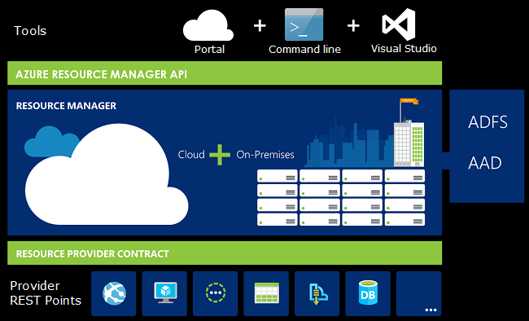
What is ARM?
Resource
Resource Group
Resource Provider
Resource Manager Template
Notes:
Terminology
If you are new to Azure Resource Manager, there are some terms you might not be familiar with.
resource - A manageable item that is available through Azure. Some common resources are a virtual machine, storage account, web app, database, and virtual network, but there are many more.
resource group - A container that holds related resources for an Azure solution. The resource group can include all the resources for the solution, or only those resources that you want to manage as a group. You decide how you want to allocate resources to resource groups based on what makes the most sense for your organization. See Resource groups.
resource provider - A service that supplies the resources you can deploy and manage through Resource Manager. Each resource provider offers operations for working with the resources that are deployed. Some common resource providers are Microsoft.Compute, which supplies the virtual machine resource, Microsoft.Storage, which supplies the storage account resource, and Microsoft.Web, which supplies resources related to web apps. See Resource providers.
Resource Manager template - A JavaScript Object Notation (JSON) file that defines one or more resources to deploy to a resource group. It also defines the dependencies between the deployed resources. The template can be used to deploy the resources consistently and repeatedly. See Template deployment.
declarative syntax - Syntax that lets you state "Here is what I intend to create" without having to write the sequence of programming commands to create it. The Resource Manager template is an example of declarative syntax. In the file, you define the properties for the infrastructure to deploy to Azure.
The infrastructure for your application is typically made up of many components – maybe a virtual machine, storage account, and virtual network, or a web app, database, database server, and 3rd party services. You do not see these components as separate entities, instead you see them as related and interdependent parts of a single entity. You want to deploy, manage, and monitor them as a group. Azure Resource Manager enables you to work with the resources in your solution as a group. You can deploy, update, or delete all the resources for your solution in a single, coordinated operation. You use a template for deployment and that template can work for different environments such as testing, staging, and production. Resource Manager provides security, auditing, and tagging features to help you manage your resources after deployment.

Slide 24
Author ARM Templates -
JSON Document
Structure
Functions
Nesting
Dependencies
Multiple Resources (Loops)
Advanced Topics

Slide 25
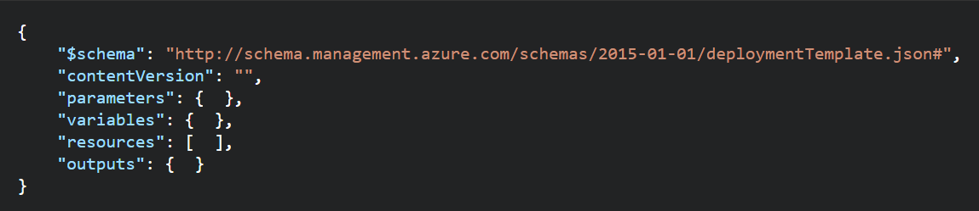
ARM Templates - Structure
Element name | Required | Description
$schema | Yes | Location of the JSON schema file that describes the version of the template language. Use the URL shown in the preceding example.
contentVersion | Yes | Version of the template (such as 1.0.0.0). You can provide any value for this element. When deploying resources using the template, this value can be used to make sure that the right template is being used.
parameters | No | Values that are provided when deployment is executed to customize resource deployment.
variables | No | Values that are used as JSON fragments in the template to simplify template language expressions.
resources | Yes | Resource types that are deployed or updated in a resource group.
outputs | No | Values that are returned after deployment.
Notes:
https://docs.microsoft.com/en-us/azure/azure-resource-manager/resource-group-authoring-templates

Slide 26
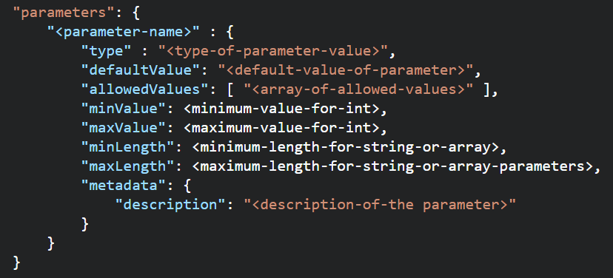
ARM Templates - Parameters
Element name | Required | Description
parameterName | Yes | Name of the parameter. Must be a valid JavaScript identifier.
type | Yes | Type of the parameter value. See the list of allowed types after this table.
defaultValue | No | Default value for the parameter, if no value is provided for the parameter.
allowedValues | No | Array of allowed values for the parameter to make sure that the right value is provided.
minValue | No | The minimum value for int type parameters, this value is inclusive.
maxValue | No | The maximum value for int type parameters, this value is inclusive.
minLength | No | The minimum length for string, secureString, and array type parameters, this value is inclusive.
maxLength | No | The maximum length for string, secureString, and array type parameters, this value is inclusive.
description | No | Description of the parameter that is displayed to users through the portal.
Allowed Types
string
secureString
int
bool
object
secureObject
array
Notes:
In the parameters section of the template, you specify which values you can input when deploying the resources. These parameter values enable you to customize the deployment by providing values that are tailored for a particular environment (such as dev, test, and production). You do not have to provide parameters in your template, but without parameters your template would always deploy the same resources with the same names, locations, and properties.

Slide 27
Re-use ARM Templates
By passing in parameters to your ARM Templates, you can re-use them in many different scenarios. You can deploy full solutions with t-shirt sizing (Small, Medium, Large) based on parameters you pass in: Size of VM, # of VMs, etc.
Be aware of what values in the ARM template need to be unique when re-using templates: https://docs.microsoft.com/en-us/azure/azure-resource-manager/resource-manager-template-best-practices#resource-names
https://docs.microsoft.com/en-us/azure/azure-resource-manager/best-practices-resource-manager-design-templates

Slide 28
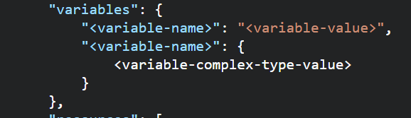
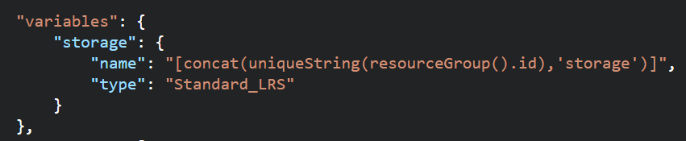
ARM Templates –Variables
Use Variables for
Use variables for values that you need to use more than once in a template.
Include variables for resource names that must be unique.
Use variables for extra manipulation of parameters
You can group variables into complex objects. Use the variable.subentry format to reference a value from a complex object.
Notes:
https://docs.microsoft.com/en-us/azure/azure-resource-manager/resource-manager-template-best-practices#variables

Slide 29
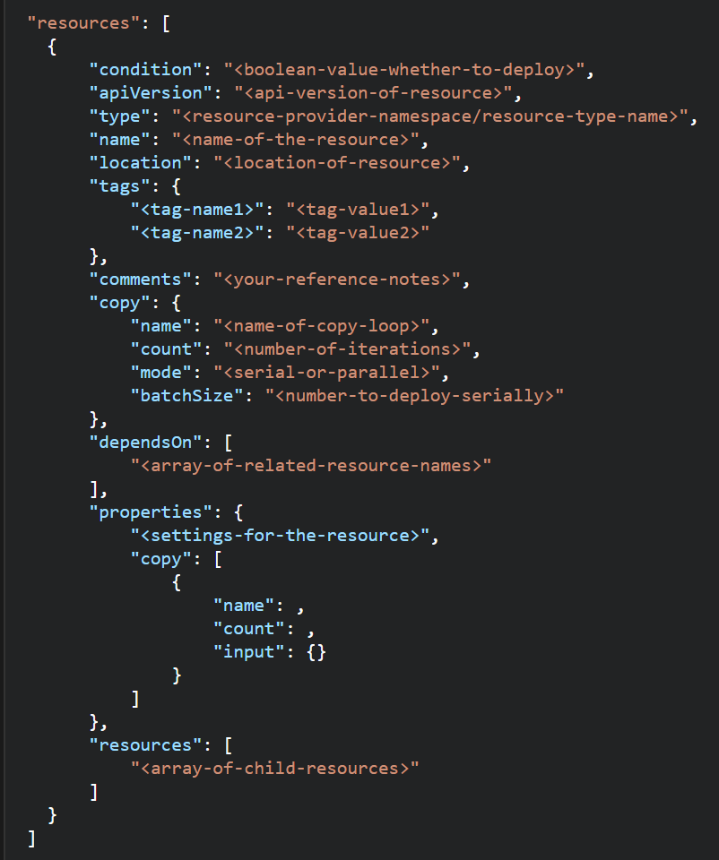
ARM Templates -Resources
When building resources:
This section can get complicated because every resource type has different properties
Use comments to describe what the resource is for.
Use tags for organizing resources
Don’t assign a public IP to a VM in the template if you don’t plan to access it directly. You can always create a public IP later if you need to login. Or, use a Load balancer NAT rule.
Some resource names must be GLOBALLY unique
You can use the uniqueString() function, a meaningful prefix, and other parameters to create names that are unique for the resource group or subscription. Globally unique is not guaranteed.
Notes:
https://docs.microsoft.com/en-us/azure/azure-resource-manager/resource-manager-template-best-practices#resources

Slide 30
ARM Templates -Resources
Element name | Required | Description
condition | No | Boolean value that indicates whether the resource is deployed.
apiVersion | Yes | Version of the REST API to use for creating the resource.
type | Yes | Type of the resource. This value is a combination of the namespace of the resource provider and the resource type (such as Microsoft.Storage/storageAccounts).
name | Yes | Name of the resource. The name must follow URI component restrictions defined in RFC3986. In addition, Azure services that expose the resource name to outside parties validate the name to make sure it is not an attempt to spoof another identity.
location | Varies | Supported geo-locations of the provided resource. You can select any of the available locations, but typically it makes sense to pick one that is close to your users. Usually, it also makes sense to place resources that interact with each other in the same region. Most resource types require a location, but some types (such as a role assignment) do not require a location. See Set resource location in Azure Resource Manager templates.
tags | No | Tags that are associated with the resource. See Tag resources in Azure Resource Manager templates.
comments | No | Your notes for documenting the resources in your template
copy | No | If more than one instance is needed, the number of resources to create. The default mode is parallel. Specify serial mode when you do not want all or the resources to deploy at the same time. For more information, see Create multiple instances of resources in Azure Resource Manager.
dependsOn | No | Resources that must be deployed before this resource is deployed. Resource Manager evaluates the dependencies between resources and deploys them in the correct order. When resources are not dependent on each other, they are deployed in parallel. The value can be a comma-separated list of a resource names or resource unique identifiers. Only list resources that are deployed in this template. Resources that are not defined in this template must already exist. Avoid adding unnecessary dependencies as they can slow your deployment and create circular dependencies. For guidance on setting dependencies, see Defining dependencies in Azure Resource Manager templates.
properties | No | Resource-specific configuration settings. The values for the properties are the same as the values you provide in the request body for the REST API operation (PUT method) to create the resource. You can also specify a copy array to create multiple instances of a property. For more information, see Create multiple instances of resources in Azure Resource Manager.
resources | No | Child resources that depend on the resource being defined. Only provide resource types that are permitted by the schema of the parent resource. The fully qualified type of the child resource includes the parent resource type, such as Microsoft.Web/sites/extensions. Dependency on the parent resource is not implied. You must explicitly define that dependency.

Slide 31
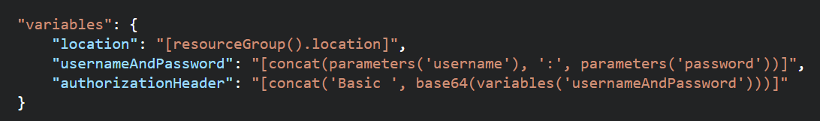
ARM Templates – Functions and Expressions
Templates are JSON
Functions and Expressions extend the JSON capabilities
They let you use some coding notions inside your templates to create or evaluate dynamic values
Functions you see often:
concat – concatenates multiple values
copyIndex – returns the index of an iteration loop
resourceGroup – access properties of this resource group, like the location.
resourceId – get the unique identifier for a resource.
All Functions: https://docs.microsoft.com/en-us/azure/azure-resource-manager/resource-group-template-functions

Slide 32
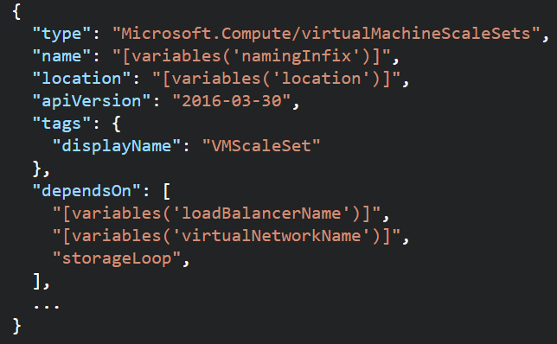
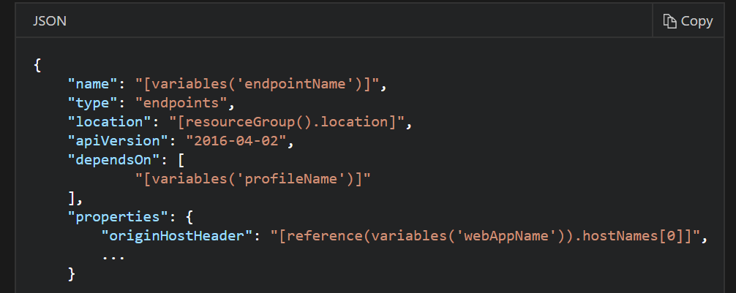
ARM Templates - Dependencies
Resources may require a dependency chain; e.g. You need a VNET before you can deploy a VM.
Use “dependsOn” property to explicitly build the dependencies between resources. Resources wont get created until their dependencies are created.
Use Child resources. Only certain resources can have child resources.
Use the “reference” function to create an implicit relationship. Resources that reference another resource are created after the referenced resource.
Notes:
https://docs.microsoft.com/en-us/azure/azure-resource-manager/resource-group-define-dependencies

Slide 33
ARM Templates Advanced Topics
Creating and Updating Resources in one ARM Template based deployment: https://docs.microsoft.com/en-us/azure/azure-resource-manager/resource-manager-update
Share state between linked templates: https://docs.microsoft.com/en-us/azure/azure-resource-manager/best-practices-resource-manager-state
Patterns for deploying resources: https://docs.microsoft.com/en-us/azure/azure-resource-manager/best-practices-resource-manager-design-templates

Slide 34
Deploy Templates

Slide 35
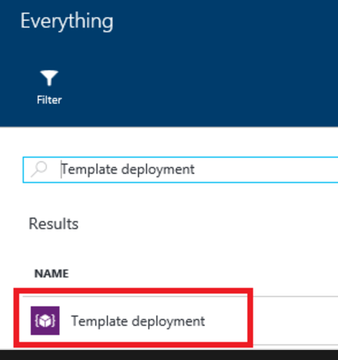
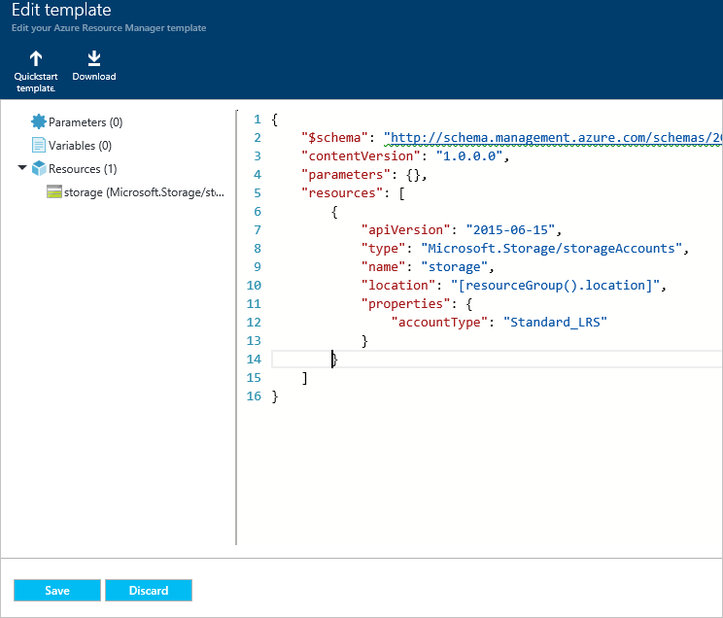
Deploy Templates – Portal, Custom Template

Slide 36
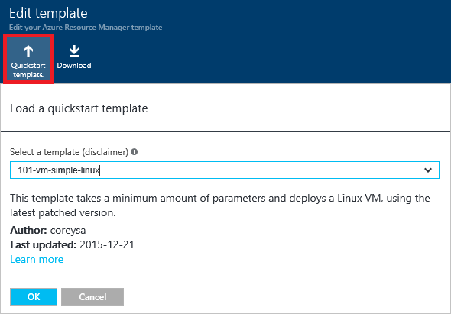
Deploy Templates – Portal, Quickstart

Slide 37
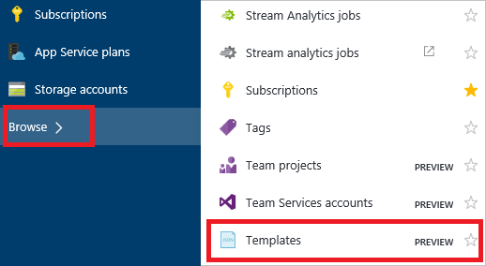
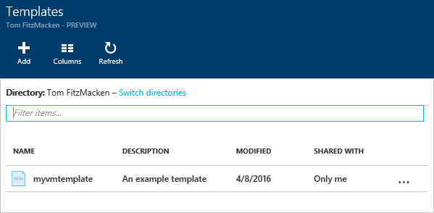
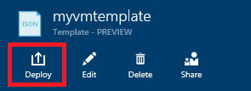
Deploy Templates – Portal, from Account

Slide 38
Deploy Templates – Portal
Create resource group
Deploy resources from Marketplace
Deploy resources from custom template
Deploy resources from a template saved to your account
Next Steps
https://docs.microsoft.com/en-us/azure/azure-resource-manager/resource-group-template-deploy-portal

Slide 39
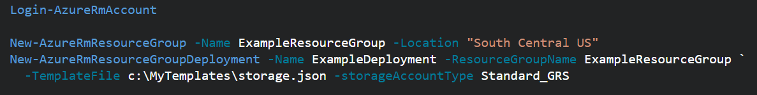
Deploy Templates - Powershell
Deploy a Template from a local json file
Deploy a Template from an external source:
Pass in a local parameter file:
Pass in an external parameter file

Slide 40
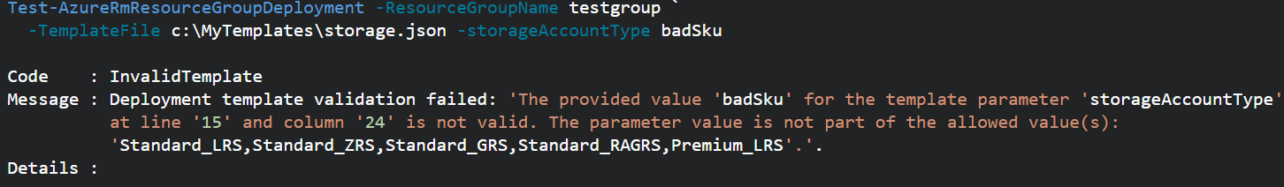
Deploy Templates - PowerShell
You can pass in parameters inline and with a local parameter file.
You CANNOT pass in parameters inline and with an external parameter file.
You can TEST a deployment before running it.
Template Deployments have 2 modes: INCREMENTAL or COMPLETE
Both modes deploy resources defined in Template.
Complete Deployment DELETES resources in group not defined in Template
Incremental does not DELETE resources not defined in Template
Use “-Mode” argument to set Mode.
Notes:
https://docs.microsoft.com/en-us/azure/azure-resource-manager/resource-group-template-deploy

Slide 41
Deploy resources with Resource Manager templates and Azure PowerShell
Deploy a template from your local machine
Deploy a template from an external source
Parameter files
Test a template deployment
Incremental and complete deployments
Sample template
Next steps
https://docs.microsoft.com/en-us/azure/azure-resource-manager/resource-group-template-deploy

Slide 42
Regional Availability

Slide 43
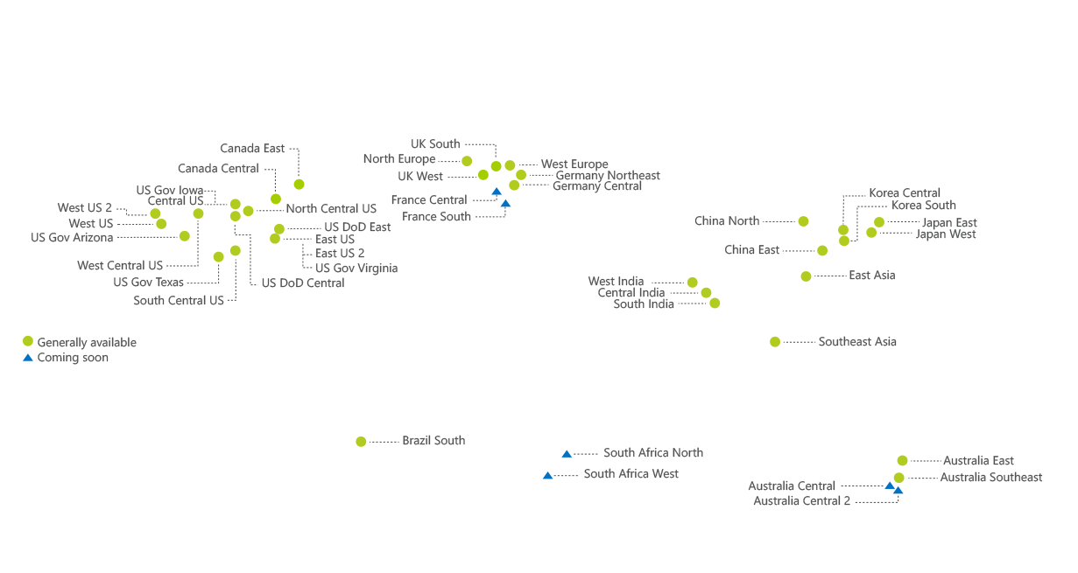

Regions
An Azure Region is a geographic region that contains a collection of data centers.
It’s more than one building.
Over 36 Azure regions
Special / Sovereign Regions
Notes:
An Azure Region is a geographic region that contains a collection of data centers. Datacenters will be in close geo proximity to each other – separate buildings
It’s more than one building.
There are over 36 Azure regions: https://azure.microsoft.com/en-us/regions/
Regions might have restrictions – eg. China - you might need a billing address in that country
All services might not be available in all regions
Special / Sovereign Regions:
US Gov Virginia/Iowa
China East, China North
Germany Central, Gemany Northeast

Slide 44
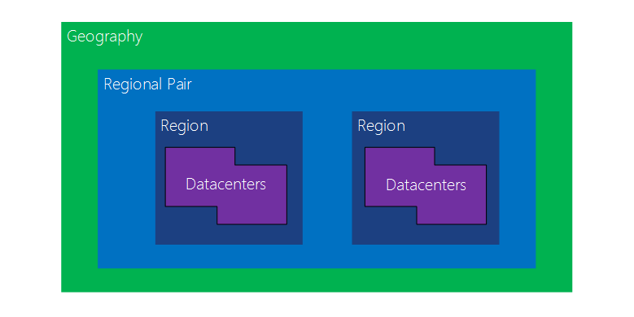
Regional Availability - Regions
Region Pairs
In same geography (such as US, Europe or Asia)
Replicated resources are replicated across pairs
In broad geographic outage, one region in the pair is prioritized
Data resides in the same geography as its pair (except Brazil South)
Azure Storage GRS and RA-GRS replicates data from one region to its pair.
Notes:
Datacenters are
An Azure Region is a geographic region that contains a collection of data centers.
It’s more than one building.
There are over 36 Azure regions: https://azure.microsoft.com/en-us/regions/
Special / Sovereign Regions:
US Gov Virginia/Iowa
China East, China North
Germany Central, Gemany Northeast
Region Pairs
In same geography (such as US, Europe or Asia)
Replicated resources are replicated across pairs
In broad geographic outage, one region in the pair is prioritized
Data resides in the same geography as its pair (except Brazil South)
Pairs: https://docs.microsoft.com/en-us/azure/best-practices-availability-paired-regions#what-are-paired-regions
Azure Storage GRS and RA-GRS replicates data from one region to its pair.

Slide 45
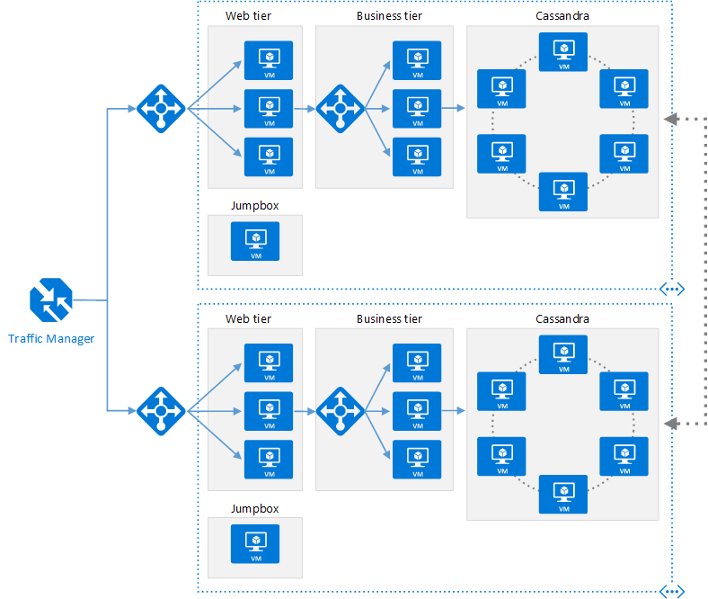
Regional Availability - Design
Primary/Secondary Region for Higher Availability
Traffic Manager routes requests
Put Primary, Secondary and Traffic Manager is separate regions
Make sure each region’s VNET IP range does not overlap
The same ARM template can be deployed, with minor parameter changes for VNET IP address space, and Resource locations.
Notes:
Microsoft Azure Traffic Manager allows you to control the distribution of user traffic for service endpoints in different datacenters. Service endpoints supported by Traffic Manager include Azure VMs, Web Apps, and cloud services. You can also use Traffic Manager with external, non-Azure endpoints.+
Traffic Manager uses the Domain Name System (DNS) to direct client requests to the most appropriate endpoint based on a traffic-routing method and the health of the endpoints. Traffic Manager provides a range of traffic-routing methods and endpoint monitoring options to suit different application needs and automatic failover models. Traffic Manager is resilient to failure, including the failure of an entire Azure region.

Slide 46
Regional Availability - Design
Configurations
Active/passive with hot standby (rec)
Active/passive with cold standby
Active/active
Use Regional Pairing
In broad outage, one region from pair is prioritized
Data residency issues mitigated
Traffic Manager
routing = priority,
health probe = write a custom service that reports accurately
Read Reference Architecture Here.
https://docs.microsoft.com/en-us/azure/architecture/reference-architectures/virtual-machines-linux/multi-region-application

Slide 47
High Availability
Availability within a region vs. Regional Availability
Azure Storage makes 3 copies of data within a region (including VM disks)
Use Availability Sets
Design loosely coupled service with asynchronous communication. Use Azure Storage queues or Azure Sevice Bus for queue-centric workflow.
Fault Detection and Retry Logic within your application
Circuit Breaker Pattern
Immutable Infrastructure, Infrastructure as Code
https://docs.microsoft.com/en-us/azure/architecture/resiliency/high-availability-azure-applications
https://docs.microsoft.com/en-us/azure/architecture/resiliency/index#designing-for-resiliency

Slide 48
I have an application that processes images locally before saving them to permanent storage. I need some disk space to temporarily store these files. What is the most cost effective option?
Azure File Storage
Azure Data Disk
Azure Blob Storage
Azure VM's Temporary Disk

Slide 49
I have an application that processes images locally before saving them to permanent storage. I need some disk space to temporarily store these files. What is the most cost effective option?
Azure File Storage
Azure Data Disk
Azure Blob Storage
Azure VM's Temporary Disk

Slide 50
I have an application that requires a consist and guaranteed amount of IOPS and throughput for accessing data on disks. What is the most cost effective option?
Azure File Storage
Azure Standard Storage Disks
Azure Premium Storage Disks
Standard Managed Disks

Slide 51
I have an application that requires a consist and guaranteed amount of IOPS and throughput for accessing data on disks. What is the most cost effective option?
Azure File Storage
Azure Standard Storage Disks
Azure Premium Storage Disks
Standard Managed Disks

Slide 52
My VM needs an "F" drive with at least 2TB of space. Which of the following do I need to consider when designing my VM?
Azure File Storage
Azure Standard Storage Disks
Azure Premium Storage Disks
Standard Managed Disks

Slide 53
My VM needs an "F" drive with at least 2TB of space. Which of the following do I need to consider when designing my VM?
Azure File Storage
Azure Standard Storage Disks
Azure Premium Storage Disks
Standard Managed Disks

Slide 54
I need to create a VM with one data disk. I must be able to export the disk to a VHD file and host in a storage account and I need to take snapshots of the disk. Which of the following can I use?
Standard Unmanaged Disk
Premium Unmanaged Disk
Standard Managed Disk
Premium Managed Disk

Slide 55
I need to create a VM with one data disk. I must be able to export the disk to a VHD file and host in a storage account and I need to take snapshots of the disk. Which of the following can I use?
Standard Unmanaged Disk
Premium Unmanaged Disk
Standard Managed Disk
Premium Managed Disk

Slide 56
I've created a VM with a database installed and configured. It uses 2 Data Disks. I need to be able to deploy this VM in multiple scenarios. What is the simplest way to redeploy this VM multiple times?
Take a snapshot
Capture an image
Build an ARM Template
Export to a VHD file

Slide 57
I've created a VM with a database installed and configured. It uses 2 Data Disks. I need to be able to deploy this VM in multiple scenarios. What is the simplest way to redeploy this VM multiple times?
Take a snapshot
Capture an image
Build an ARM Template
Export to a VHD file

Slide 58
Every VM in an availability set gets:
One Fault Domain, One Update Domain
Two Fault Domains, One Update Domain
One Fault Domain, Two Update Domains
Two Fault Domains, Two Update Domains

Slide 59
Every VM in an availability set gets:
One Fault Domain, One Update Domain
Two Fault Domains, One Update Domain
One Fault Domain, Two Update Domains
Two Fault Domains, Two Update Domains

Slide 60
To build a highly available VM solution, I need at least 2 VMs in
The Same Azure Region
The Same Resource Group
The Same Vnet
The Same Availability Set
The Same Load Balancer Backend Pool

Slide 61
To build a highly available VM solution, I need at least 2 VMs in
The Same Azure Region
The Same Resource Group
The Same Vnet
The Same Availability Set
The Same Load Balancer Backend Pool

Slide 62
To deploy an externally available Azure ARM Template, but keep it secure, I can:
Host it in a public Azure storage container
Host it in our on-premises corporate network
Host in a private Azure storage container and use a SAS token
Host it in a private Github repository

Slide 63
To deploy an externally available Azure ARM Template, but keep it secure, I can:
Host it in a public Azure storage container
Host it in our on-premises corporate network
Host in a private Azure storage container and use a SAS token
Host it in a private Github repository

Slide 64
My ARM Template needs to manipulate strings to name and reference the resources correctly. The easiest way to do this is:
Add a custom script extension that can execute powershell or Bash
Generate the correct strings externally and pass them in as parameters
Use complex objects as ARM Template variables
Use ARM Template functions.

Slide 65
My ARM Template needs to manipulate strings to name and reference the resources correctly. The easiest way to do this is:
Add a custom script extension that can execute powershell or Bash
Generate the correct strings externally and pass them in as parameters
Use complex objects as ARM Template variables
Use ARM Template functions.

Slide 66
My solution needs to be always available, even if an entire Azure region suffers an outage. What is my best option from among the following?
Deploy a primary solution to an Azure region nearest my customer, and a secondary solution in the same region as well
Deploy a primary solution to an Azure region nearest my customer, and a secondary solution geographically as far from my primary region as possible
Deploy a primary solution to an Azure region nearest my customer, and a secondary solution in the primary's paired Azure region
Deploy a primary solution to an Azure region nearest my customer, and a secondary solution in the closest geographical region

Slide 67
My solution needs to be always available, even if an entire Azure region suffers an outage. What is my best option from among the following?
Deploy a primary solution to an Azure region nearest my customer, and a secondary solution in the same region as well
Deploy a primary solution to an Azure region nearest my customer, and a secondary solution geographically as far from my primary region as possible
Deploy a primary solution to an Azure region nearest my customer, and a secondary solution in the primary's paired Azure region
Deploy a primary solution to an Azure region nearest my customer, and a secondary solution in the closest geographical region

